Slide 1

Boolean Algebras and Boolean Functions

Slide 2

Boolean algebras and Boolean functions

Slide 3
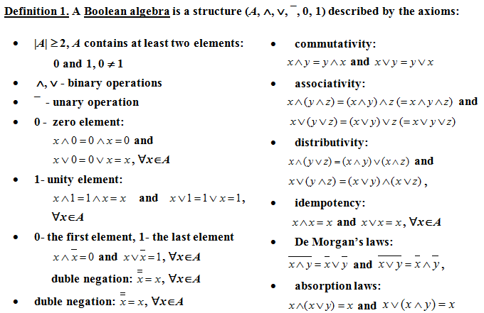
Boolean Algebra

Slide 4
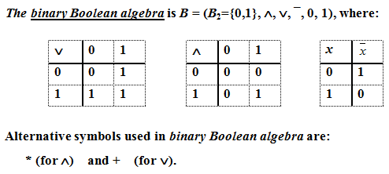
Example 1

Slide 5
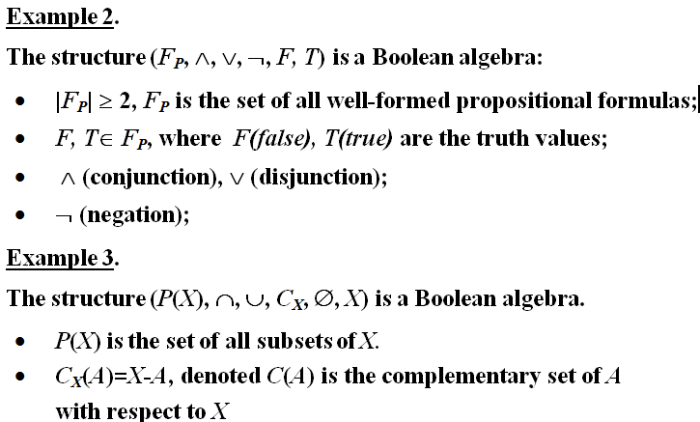

Slide 6
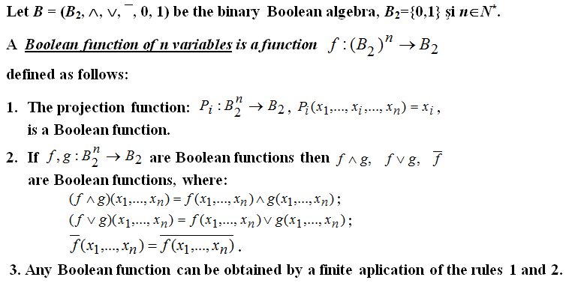
Boolean functions

Slide 7
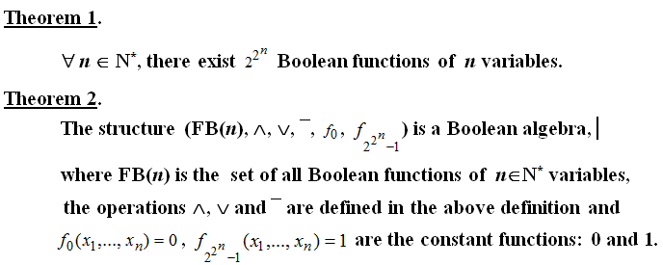
Theorems

Slide 8

Example 4

Slide 9




Slide 10
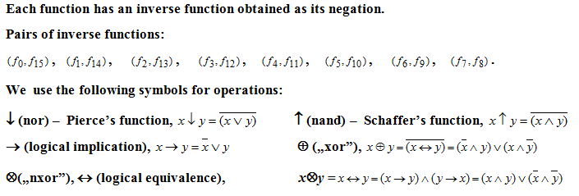
Example 5 (contd.)

Slide 11
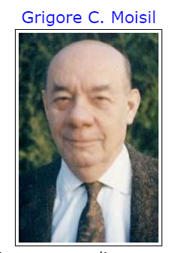

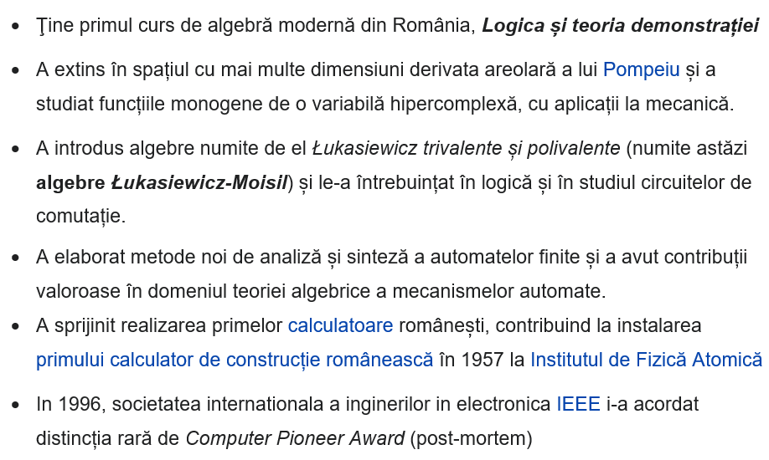
(1906 -1973)
https://www.youtube.com/watch?v=vALliqzw_SU

Slide 12
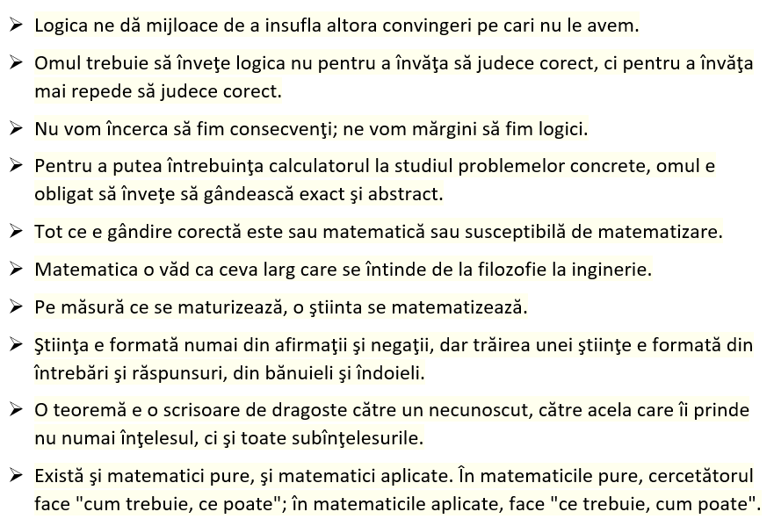
Moisil – citate celebre

Slide 13
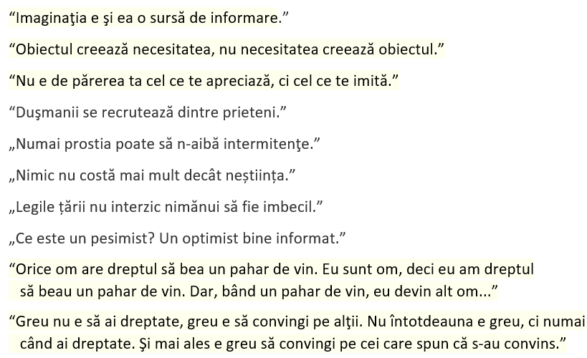
Moisil – citate celebre

Slide 14
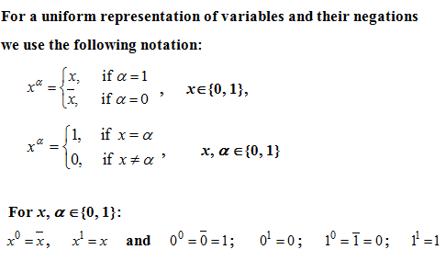
Notations

Slide 15
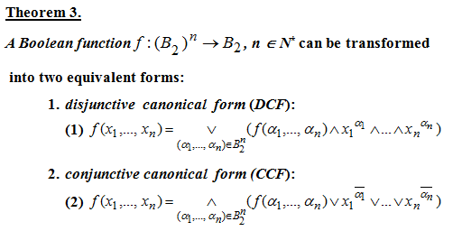
Canonical forms of Boolean functions

Slide 16
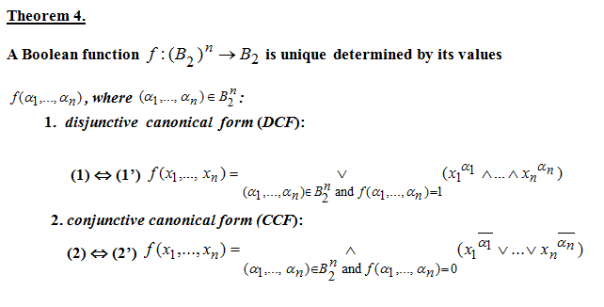
Canonical forms of Boolean functions

Slide 17
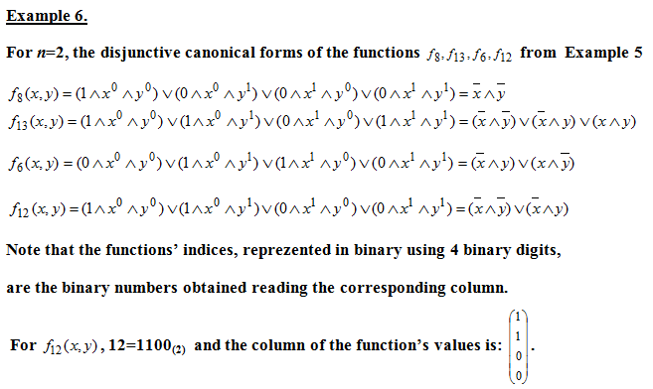

Slide 18
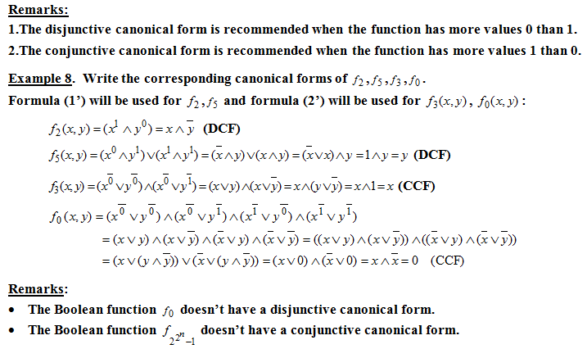

Slide 19
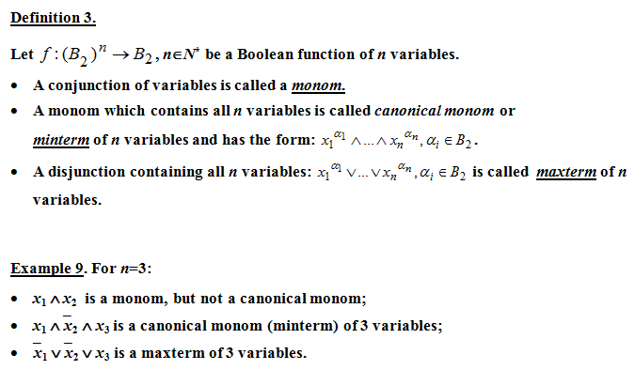
Minterms and Maxterms

Slide 20
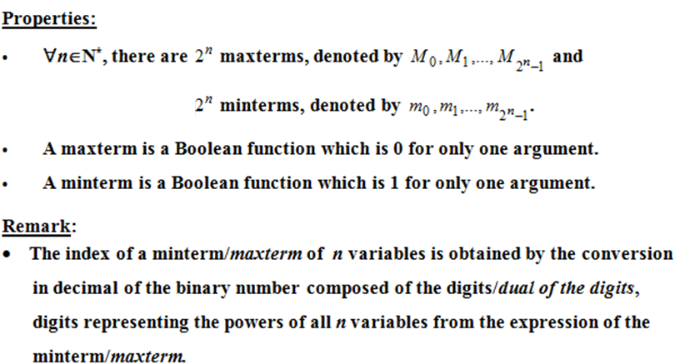
Minterms and maxterms - properties

Slide 21

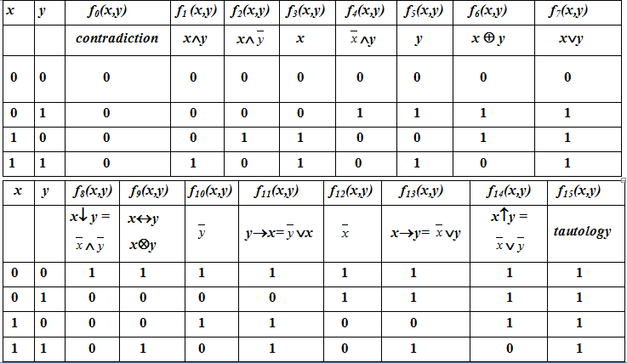

Slide 22
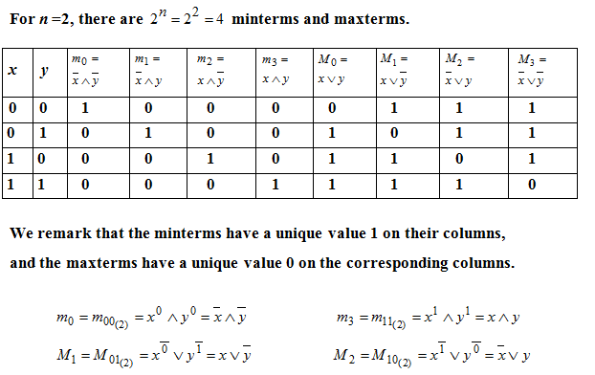
Example 10

Slide 23

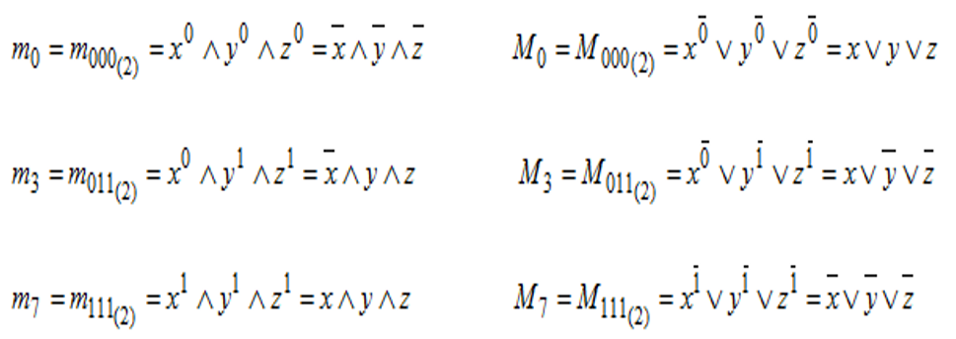
Example 11

Slide 24
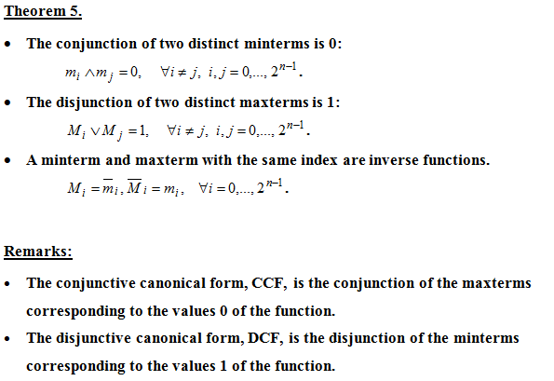

Slide 25
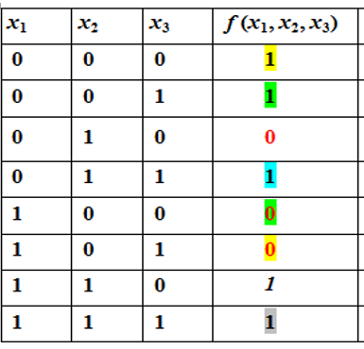
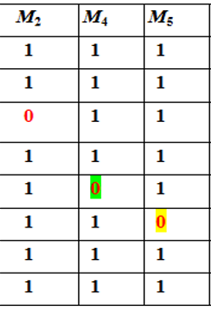
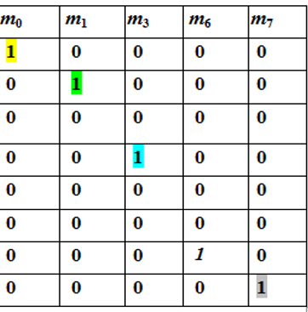

Example 12 Write the canonical forms of the function.

